Slide 1
Demonstrating Pythagoras' theorem
Task A: Creating triangles from combinations of squares
Before attempting questions on task A, please print out the squares on the next page.
1) Create a triangle by joining the vertices of the squares with areas of 1 unit², 3 units², and 5 units².
Using a protractor, measure the size of each angle in this triangle.
smallest angle
middle angle
largest angle
2) Explain why you cannot create an equilateral triangle using a combination of the squares you have been given.
3) Two triangles can be created by joining the vertices of the following:
- squares with areas of 2 units², 5 units², 6 units² (triangle X)
- squares with areas of 4 units², 10 units², 12 units² (triangle Y)
a) Create these two triangles and measure each of their angles with a protractor.
b) Write down what you notice about the angles between each of these triangles. Can you explain your observations?
4) Create a triangle that is similar to a triangle made from squares with areas 21 units², 27 units², 39 units². Which squares did you use?
smallest square
middle square
largest square
5) Create 3 isosceles triangles from the following squares:
- 4 units², 4 units², 12 units² (triangle A)
- 6 units², 6 units², 12 units² (triangle B)
- 1 units², 8 units², 8 units² (triangle C)
6) Complete the table by joining three squares and writing down whether the largest angle is: acute, obtuse, or right.
After choosing three squares, can you predict what type of angle you’ll get before you join up the squares?
a) Measure the largest angle of each triangle with a protractor.
b) Which triangle has as its largest angle:
triangle A
triangle B
triangle C
areas of the three squares | largest angle | areas of the three squares | largest angle
7, 10, 13 | acute
4, 5, 11
4, 9, 13
3, 10, 13
5, 6, 7
an acute angle?
a right angle?
an obtuse angle?
‹#›

Slide 2
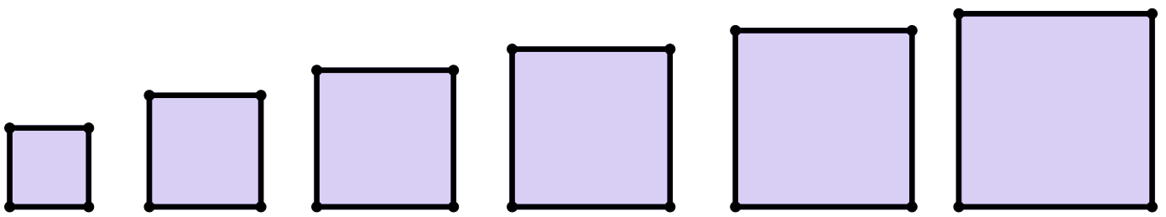
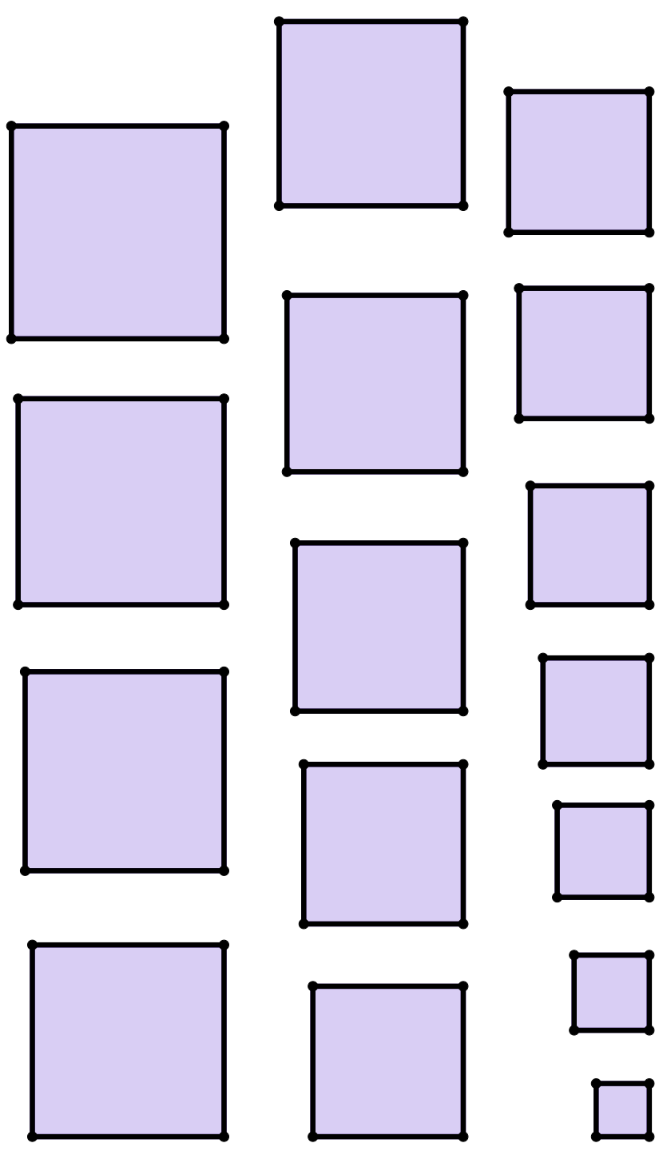
Demonstrating Pythagoras' theorem
12 units²
12 units²
7
units²
16 units²
10 units²
11 units²
6
units²
15 units²
5 units²
8
units²
10 units²
14 units²
4 units²
6
units²
9
units²
3
units²
4 units²
13 units²
2
units²
8
units²
2
units²
1
unit²
‹#›

Slide 3
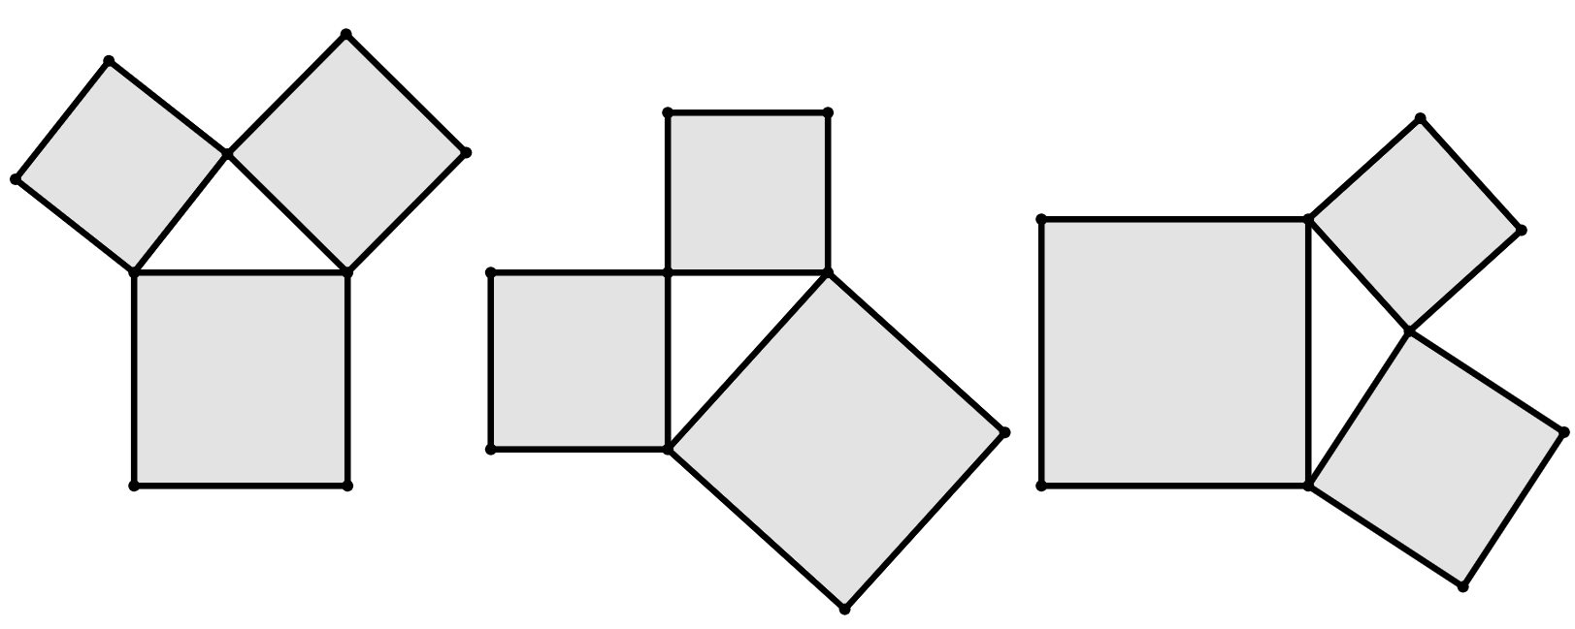
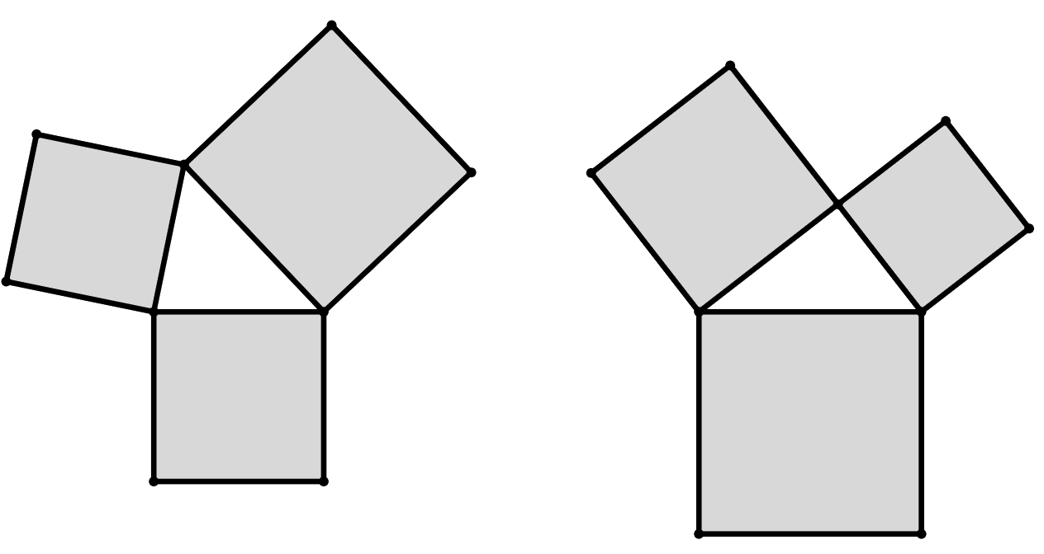
Demonstrating Pythagoras' theorem
Task B: Properties from summing the areas of squares
1) For each of these triangles, draw on an angle marker at the largest interior angle of the triangle.
For each angle marked, write down whether it is acute, right, or obtuse.
a)
8
units²
10
units²
9
units²
c)
b)
8
units²
16 units²
11
units²
25
units²
20
units²
12
units²
2) The largest angle in this triangle is marked with an angle marker and is acute.
Write down a possible area of the largest square.
3) The largest angle in this triangle is a right angle.
Write down the area of the unlabelled square.
15
units²
11
units²
14
units²
24
units²
4) Each group shows the areas of three squares whose vertices are joined to create a triangle.
Place each group into the correct part of the table that describes the size of its largest angle.
largest angle is acute | largest angle is obtuse | largest angle is right
16, 18, 20 | 9, 13, 26 | 8, 13, 21
1, 1, 3
3, 3, 5
4, 7, 10
16, 17, 40
8, 17, 25
9, 16, 25
14a, 19a, 44a
5x, 7x, 12x
Mathematics in Education and Industry.
‹#›

